Slide 1
INEQUALITIES

Slide 2
Inequalities:
There are two types of questions in Inequality –
1) Direct Inequality
2) Coded Inequality
Both kinds of questions can be solved easily once you have gone through the below tables.

Slide 3
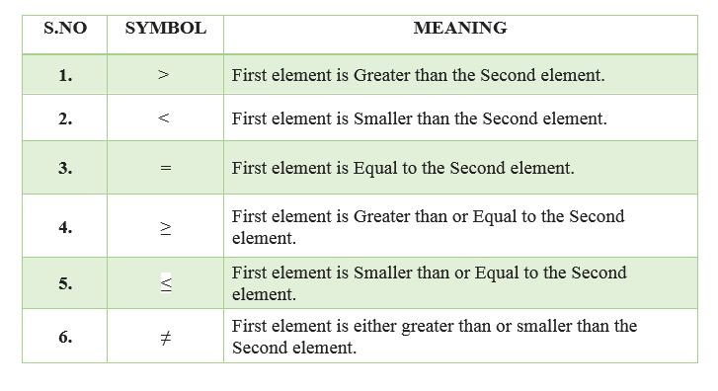
In order to understand questions on inequality first you need to have an overview of various terminologies which are used in such questions –

Slide 4
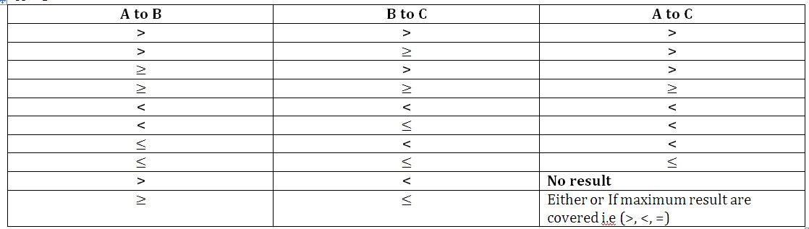

Slide 5
Practice examples:
1. Statement: P > Q > R < S ≥ T
Conclusions:
A) P > R B) P > S C) R = T D) R > T
2. Statement: P < Q ≤ R < S > T > U≠Z
Conclusions:
A) P < S B) Q ≤ S C) R > T D) P ≤R
3. Statement: M≤ N≤ O< P; K = L≥ O > C
Conclusions:
A) M ≤ P B) K ≥ N C) P ≥ K D) M = C
Ans:
1. A
2. A
3. B

Slide 6
Directions (4-6): Choose the correct option from the following options:
A. if only conclusion I follow.
B. if only conclusion II follow.
C. if either conclusion I or conclusion II follows.
D. if neither conclusion I nor conclusion II follows.
E. if both conclusions I and II follow.
4. Statements: P < Q ≤ S = T, R = Q < U, V > U
Conclusions: I. P > U II. V > T
5. Statements: U ≥ X = Y, Y ≤ Z ≤ S, T = W > Z
Conclusions: I. T ≤ U II. S > U
6. Statements: A ≥ P = S > T, V < B = T ≥ X
Conclusions: I. A > X II. P < B
Ans:
4. D 5. D 6. A

Slide 7
Directions(7-11):
‘P©Q’ means ‘P’ is greater than ‘Q’.
‘P%Q’ means ‘P’ is smaller than ‘Q’.
‘P@Q’ means ‘P’ is either greater than or equal ‘Q’.
‘P$Q’ means ‘P’ is either smaller than or equal to ‘Q’.
‘P#Q’ means ‘P’ is equal to ‘Q’.
A) If only conclusion I is true.
B) If only conclusion II is true.
C) If either conclusion I or II is true.
D) If neither conclusion I nor II is true.
E) If both conclusions I and II are true

Slide 8
7. Statements: M @ R, R ©F, F#L
Conclusions:
I. R@L II. M@L
Ans: D
8. Statements: T % J, J @ V, V # W
Conclusions:
I. T©W II. W@T
Ans: C

Slide 9
9. Statements: J @ D, D$ L, L#N
Conclusions:
I. J # L II. J $ L
Ans: D
10. Statements: R $ M, M%H,H$F
Conclusions:
I. R % F II. M $ F
Ans: A
11. Statements: K $ H, H % I, I © F
Conclusions:
I. K $ I II. H % F
Ans: D

Slide 10
Practice questions:
1. In the question symbols *, @, %, $ and # are used with the following meaning.
'P $ Q' means 'P is not greater than Q'
'P * Q' means 'P is neither smaller than nor greater than Q'
'P # Q' means 'P is neither greater than nor equal to Q'
'P % Q' means 'P is not smaller than Q'
'P @ Q' means 'P is neither smaller than nor equal to Q'
Assuming the statements to be true, find out which of the two conclusions I and II is/are definitely true.
Statements:
D % H, K * H, H $ R
Conclusions
I. K $ R
II. D % K
(a) Only conclusion I is true
(b) Only conclusion II is true
(c) Either conclusion I or II is true
(d) Neither conclusion I nor II
is true
(e) Both follows

Slide 11
2. Given signs signify something and on that basis, assume the given statements to be true and find which of the two conclusions I and II is/are definitely true.
A+B means A is equal to B
A-B means A is less than B
A=B means A is not equal to B
A*B means A is greater than equal to B
A/B means A is less than equal to B
Statements
K+L, K/M, M-N
Conclusions
I) M+L
II) K-N
(a) Only conclusion I is true
(b) Only conclusion II is true
(c) Neither conclusion I nor II is true
(d) Both conclusions I and II are true

Slide 12
3. Study the following information to answer the given questions
P$Q means P is not smaller than Q
P@Q means P is neither smaller than nor equal to Q
P#Q means P is neither greater than nor equal to Q
P&Q means P is neither greater than nor smaller than Q
P*Q means P is not greater than Q
Statements: A $ M, P @ L, K # P, A $ L
Conclusions:
I. K # L II. A @ P
III.L*A IV.M # P
A. None is true
B. Only I is true
C. Only II is true
D. Only III is true
E. Only IV is true
ANS: D

Slide 13
4. In the following questions, the symbols @, $, %, # and © are used with the following meanings illustrated—
‘X @ Y’ means ‘X is not smaller than Y’.
‘X $ Y’ means ‘X is not greater than Y’.
‘X % Y’ means ‘X is neither smaller than nor equal to Y’.
‘X # Y’ means ‘X is neither greater than nor equal to Y’.
‘X © Y’ means ‘X is neither smaller than nor greater than Y’.
In the following question assuming the given statements to be true, find out which of the two conclusions I and II given below them is/are definitely true. Give answer
(a)If only I is true.
(b)If only II is true.
(c)If either I or II is true
(d)If neither I nor II is true.
(e)If both I and II are true.
1. Statement: P $ T, T @ L,U % L
Conclusions: I. P @ L II. U©L
2.Statements: A@B, B%D, D©K
Conclusions: I. A©K II. B%K

Slide 14
5. Given signs signify something and on that basis, assume the given statements to be true and find which of the two conclusions I and II is/are definitely true.
A * B means A is not greater than B.
A │B means A is nether smaller than nor equal to B.
A / B means A is not smaller than B.
A \ B means A is neither greater than nor equal to B.
A ? B means A is neither greater than nor smaller than B.
Statements:
M ? S │ Q │ P, R / P, T \ P
Conclusions:
I) M │ T
II) Q \ R
(a) Only conclusion I is true
(b) Only conclusion II is true
(c) Neither conclusion I nor II is
true
(d) Both conclusions I and II are
true

Slide 15
6. Given signs signify something and on that basis, assume the given statements to be true and find which of the two conclusions
I and II is/are definitely true.
A+B means A is greater than equal to B
A-B means A is equal to B
A€B means A is less than B
A*B means A is equal to B
A/B means A is greater than equal to B
Statements:
D * G, G – H, H / J
Conclusions:
I) D ≠ H
II) G / J
(a) Only I is true
(b) Only II is true
(c) Both are correct
(d) None of these are true

Slide 16
7. Given signs signify something and on that basis, assume the given statements to be true and find which of the two conclusions I and II is/are definitely true.
A+B means A is equal to B
A-B means A is less than B
A=B means A is not equal to B
A*B means A is greater than equal to B
A/B means A is less than equal to B
Statements:
Q+R, R*S, S–T
Conclusions:
I) S*T
II) Q=R
(a) Only conclusion I is true
(b) Only conclusion II is true
(c) Neither conclusion I nor II
is true
(d) Both conclusions I and II
are true

Slide 17
